Slide 1
Phenomenon that affect Channel performance
Upena Dalal “ Wireless Communication” 5.2 5.3 5.9 6.1 6.5 6.6
or
Vijay garg wireless n/w evolution chapter 3

Slide 2
Basic propagation mechanisms
The distances the radio waves cover may vary
Long distance(using satellite link)
Short distance(wi-fi etc.)
For both cases, the radio propagation characteristics is completely different.
The signals reaching their final destinations will be affected by very different ways.

Slide 3
Radio propagation categories for long distance case:
Free space propagation
Ground wave propagation
Sky wave(ionospheric propagation)
Tropospheric propagation
Short-Distance mobile communication case:
Multipath propagation

Slide 4
Free Space Propagation model
The free space propagation model is used to predict received signal strength when the transmitter and receiver have a clear, unobstructed line-of-sight path between them.
Free space is the space that does not have normal radiation and propagation of the radio waves,magnetic or gravitational fields,solid bodies and ionized particles.
Unlikely to exist ,definitely not near the earth.

Slide 5
Used to study propagation in a simplified manner and later used in actual scenario for long distance.
Power density:
Radiated power per unit area.
Reduces for long distance.

Slide 6
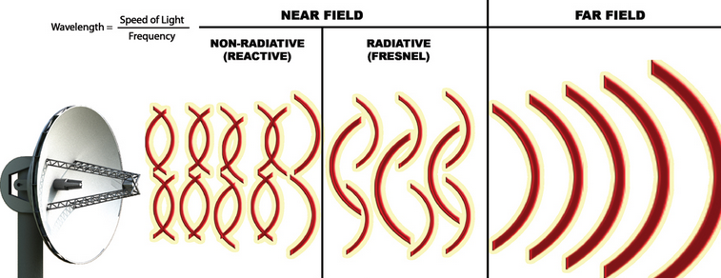
Free Space Propagation

Slide 7
FRIIS FREE SPACE MODEL
Model assumes a transmit antenna and receiver antenna to be located in free space(empty environment).
For far – field region(we also call it Fraunhofer region) the radiating antenna is just a point of source without any physical dimensions.

Slide 8
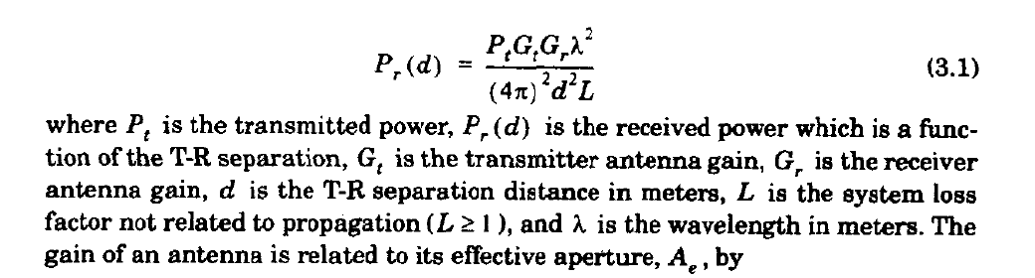
The free space power received by a receiver antenna which is separated from a radiating transmitter antenna by a distance d, is given by the Friis free space equation,
Where
P_{t} is the transmitted power,
P_{r} (d) is the received power which is a of the T-R separation,
G_{t} is the transmitter antenna gain,
G_{r} is the receiver antenna gain,
d is the T-R separation distance in meters,
L is the system loss factor not related to propagation (L ≥ 1), and
λ is the wavelength in meters.

Slide 9
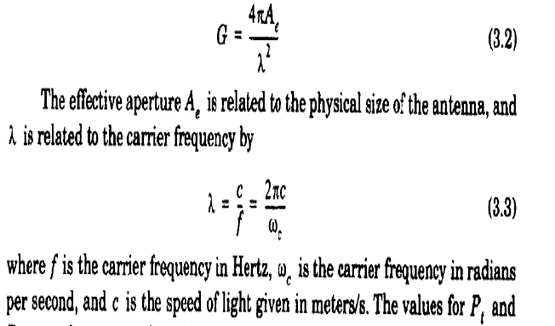
The gain of an antenna is related to its effective aperture, Ae by

Slide 10
The values for P_{t} and P_{r} must be expressed in the same units,
and G_{t} and G_{r} are dimensionless quantities.
The miscellaneous losses L (L ≥ I ) are usually due to transmission line attenuation, filter losses, and antenna losses in the communication system. A value of L = 1 indicates no loss in the system hardware.
The Friis free space equation of (3.1) shows that the received power falls off as the square of the T-R separation distance. This implies that the received power decays with distance at a rate of 20 dB/decade.

Slide 11
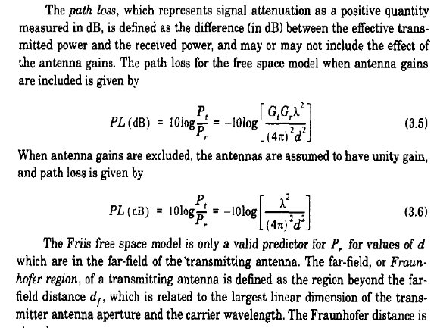

Slide 12
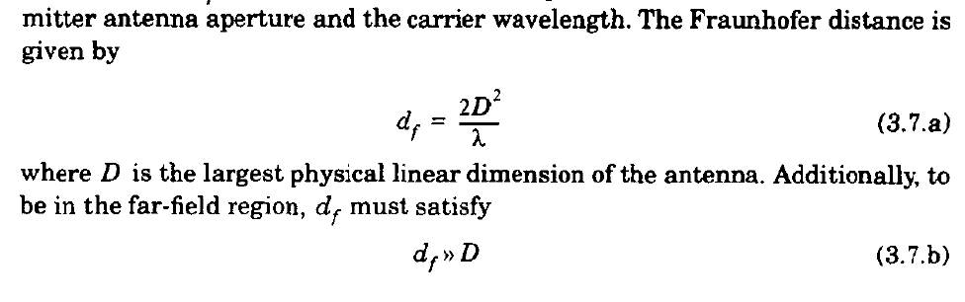

Slide 14
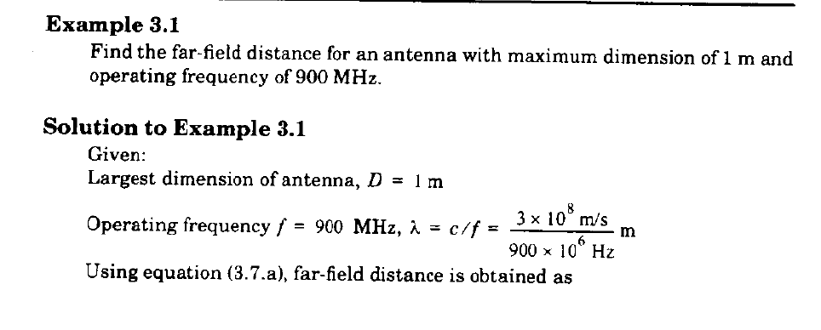

Slide 15
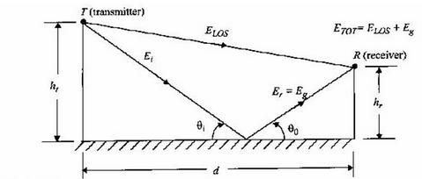
2 ray model

Slide 16
Multipath effect/fading in land mobile systems
Small scale fading
Large scale fading

Slide 17
Shadowing(large scale)
Long distance
Signal energy is absorbed and reflected by the atmosphere ,the curvature of the earth and obstacles.(trees, mountains etc.)

Slide 18
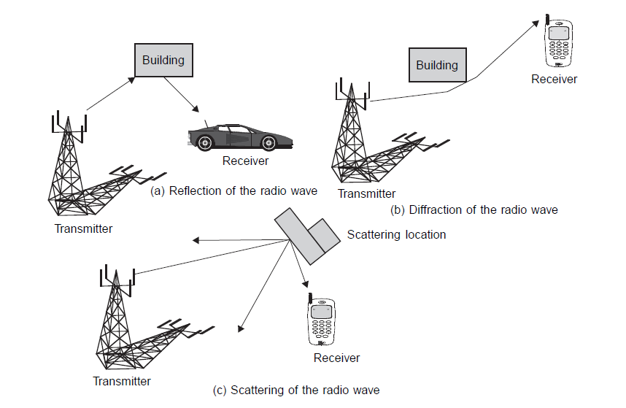
Reflection, Diffraction and Scattering(small scale fading)
Notes:
Reflection occurs when radio wave propagating in one medium impinges upon another medium with different electromagnetic properties.
Diffraction is a phenomenon by which propagating radio waves bend or deviate in the neighborhood of obstacles. Diffraction results from the propagation
of wavelets into a shadowy region caused by obstructions such as walls, buildings, mountains, and so on.
Scattering occurs when a radio signal hits a rough surface or an object having a size much smaller than or on the order of the signal wavelength. Causes signal energy to spread out in all directions

Slide 19
effects on the signal
Listed the effects observed on the signal which make it more difficult for the receiver to accurately detect the altered signal
Delay spread effect
Doppler shift/spread

Slide 20
Doppler’s spread
Along with the multiple reflected signals ,the receiver undergoes one more effect of Dopplers spread due to its own mobility, especially vehicular mobility.

Slide 21
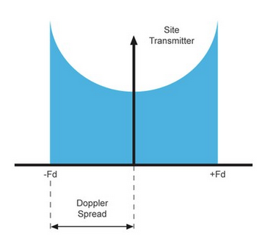
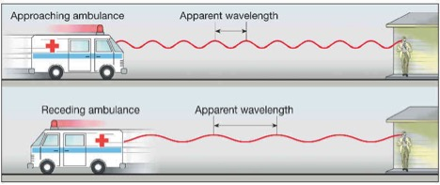
Doppler’s spread
If f_{c} is transmitted frequency, the received signal spectrum, called the Doppler spectrum, will have components
in the range f_{c} – f_{d} to f_{c} + f_{d} ,where f_{d} is the Doppler shift.
FORMULAE

Slide 22
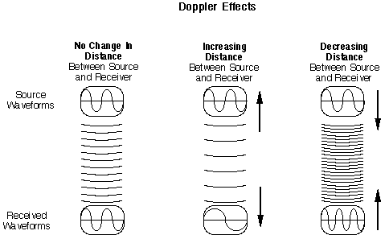
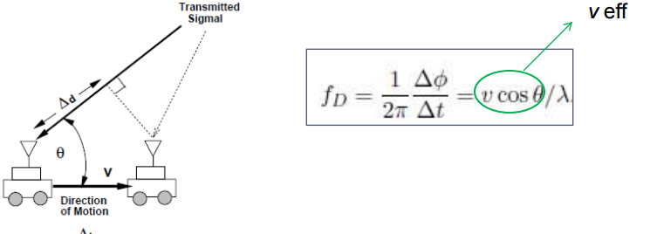
the angle θ is the angle between the direction of motion of the mobile and direction of arrival of the scattered waves.

Slide 23
Delay Spread

Slide 24
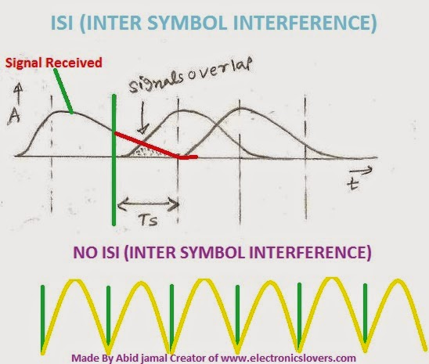
Inter-symbol Interference

Slide 25
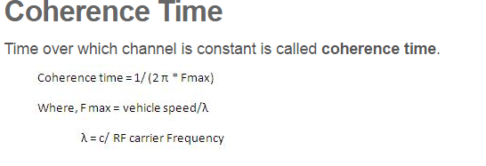
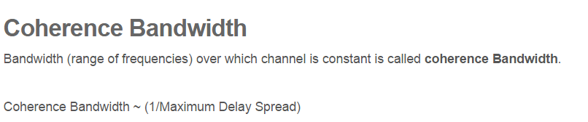

Slide 26
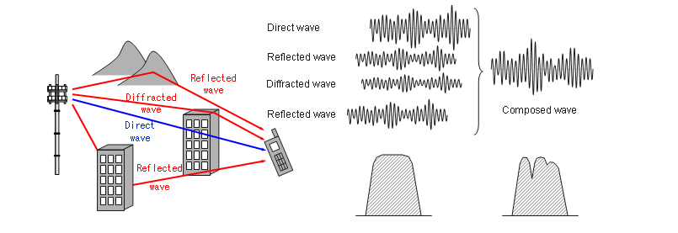
FADING

Slide 27
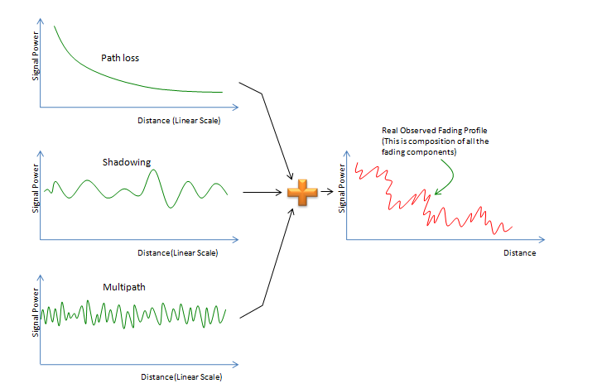

Slide 28
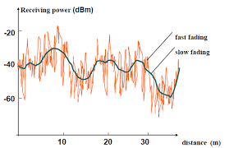

Slide 29
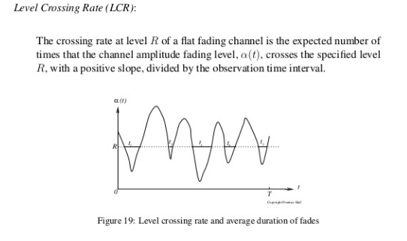

Slide 30
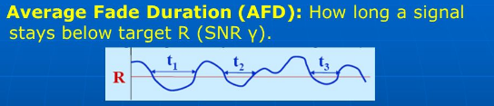

Slide 31
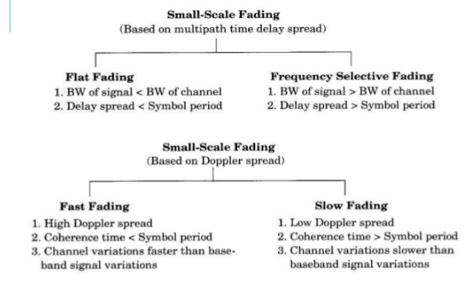
Symbol Period =1/Data Rate

Slide 32
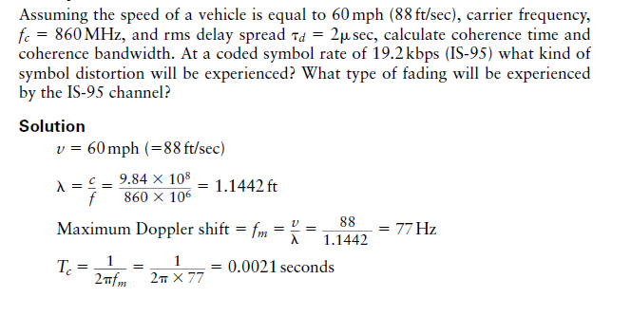
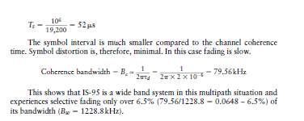

Slide 33
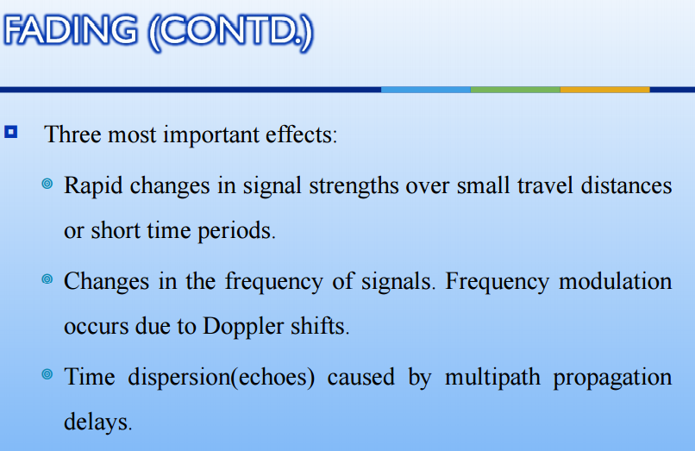

Slide 34
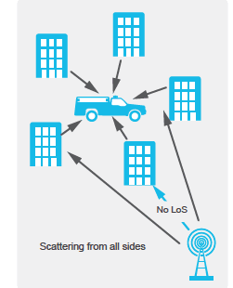
Rayleigh Fading

Slide 35
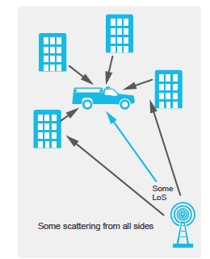
Rician Distribution

Slide 36
Problems
Q)A vehicle travels with velocity of 50 km/hr
making an angle of 45 degrees with respect to
the nearest base station and uses a carrier
frequency of 990MHz. What is the maximum
Doppler shift? Compute the number of fades
per second and average duration of fade for
the given scenario assuming ρ =1.

Slide 37
Given that an antenna receives a signal strength of 29 dBm, from a transmitting antenna with transmitting power = 4 W, find the distance of separation between the two antenna, assuming line of sight communication if transmit antenna gain = 18 dBi; receive antenna gain = 50 dBi; and transmit frequency = 12 GHz. Compute the ratio of received power to transmitted power and express it in dB.

Slide 38
In a mobile communication network of urban area, a BTS is installed at a height of 20 metres, gain of the antenna is found to be 17 dBi and the transmitted power is 43 dBm. Certain mobile station antenna is located at a height of 1.5m and has 3 dBi antenna gain.If the frequency of operation is 990MHz and the mobile station is at a distance of 20 metres from the BTS, find the received signal strength in dBm. Calculate the loss of signal strength in dB.

Slide 39
A mobile station is travelling at 30km/h, receives a flat fading sequence at 800MHz. Determine the number of fades per five seconds, above the threshold level. The threshold level is assumed to be 1/10th of the rms level.

Slide 40
A mobile station is travelling at 20km/h, receives a flat fading sequence at 900MHz. Determine the average fade duration for a threshold level which is assumed to be half of the rms level.

